Slide 1
Analysing the sentiment of IMDB Movie Reviews using NLP techniques
Group members
Intiajul Alam Shah, ID: 19301185
Sohrab Hossain, ID: 17101321
p1

Slide 2
Dataset description
50K movie reviews
35,000 highly polar movie reviews for training
15,000 for testing
2 column named ‘review’ and ‘sentiment’
Review has 49582 unique values
Sentiment has 2 unique values
p2

Slide 3
Preprocessing steps
Identify missing values and duplicates
Drop the duplicates
Describe the data using data.describe()
Convert into suitable format using label encoder
Make a copy from original to play with
Download the stopwords dataset providing by the NLTK
Data cleaning process
p3

Slide 4
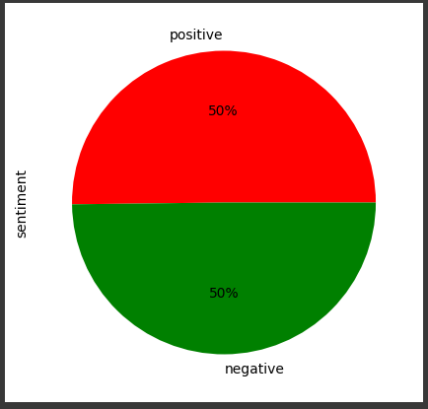
Tf-IDF vectorizer, Train-Test split, Label
Only 2 label, positive-negative
Positive-Negative ratio 50%-50%
Data split for train-test, 70-30
p4

Slide 5
Classifiers
Random Forest Classifier
Gradient Boosting
Logistic Regression
p5

Slide 6
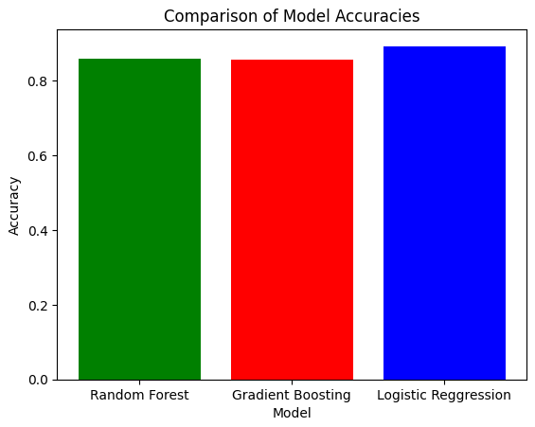
Model comparison
Random Forest
Accuracy Score 86%
Gradient Boosting
Accuracy Score 85%
Logistic Regression
Accuracy Score 89%
p6

Slide 7
Future work and Conclusion
p7

Slide 8
Thank You!
p8

